Slide 1
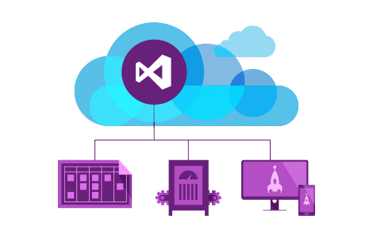
Introduction to ASP.NET Core MVC
Controllers & Actions, Routing, Razor, Identity, Areas
SoftUni Team
Technical Trainers
Software University
http://softuni.bg

Slide 2
Table of Contents
Introduction to ASP.NET Core MVC
Introduction to Controllers & Actions
Routing
Conventional & Attribute
Static File
Razor View Engine
Identity
Areas

Slide 3
Have a Question?
sli.do #csharp-web

Slide 4
ASP.NET Core
MVC
Pages
WebAPI
SignalR
Blazor
ASP.NET CORE
.NET Core
.NET Framework

Slide 5
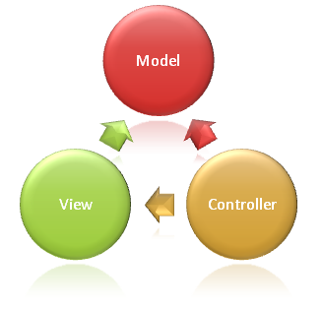
ASP.NET Core MVC Overview

Slide 6
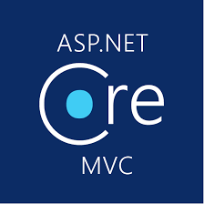
ASP.NET Core MVC
ASP.NET Core MVC is a rich framework for building web apps and APIs
Uses the Model-View-Controller design pattern
Lightweight, Open Source & Highly Testable
Optimized for use with ASP.NET Core
Provides patterns-based ways to build dynamic websites
Built-in data binding, data validation, dependency injection

Slide 7
ASP.NET Core MVC
ASP.NET Core MVC makes it easy to:
Create SEO-friendly URLs (Routing)
Create Single Page applications
Achieve Separation of Concerns
Adopt REST concepts
Implement Test-Driven Development
Achieve high-quality architecture design, optimizing developer work (Convention over Configuration)

Slide 8
ASP.NET Core MVC
ASP.NET Core MVC provides cool features like:
Razor View Engine
One of the greatest view engines
With IntelliSense, integrated in Visual Studio
Support for building Web APIs
Building services that can reach a broad range of clients
Support for cross-origin resource sharing (CORS)

Slide 9


ASP.NET Core MVC
Along with those ASP.NET Core MVC provides features like:
Routing
Model binding & model validation
Dependency injection
Strongly-typed views with the Razor view engine
Tag helpers, partial views and view components
Filters, Areas, Middlewares
And many more…

Slide 10

Hello, ASP.NET Core MVC
Creating your first ASP.NET Core MVC Project

Slide 11

Controllers and Actions

Slide 12
Controllers
The core component of the MVC pattern
All the controllers should be available in a folder name Controllers
Controller naming standard should be {name}Controller (convention)
Every controller should inherit the Controller class
Access to Request, Response, HttpContext, RouteData, TempData, ModelState, User, ViewBag / ViewData, etc.
Routes select Controllers in every request
All requests are mapped to a specific action

Slide 13
Actions
Actions are the ultimate Request destination
Public controller methods
Non-static
No return value restrictions
Actions typically return an IActionResult
public IActionResult Details(int id)
{
var viewModel = this.dataService.GetById(id).To<DetailsViewModel>();
return this.View();
}

Slide 14
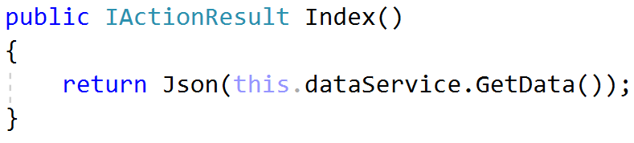
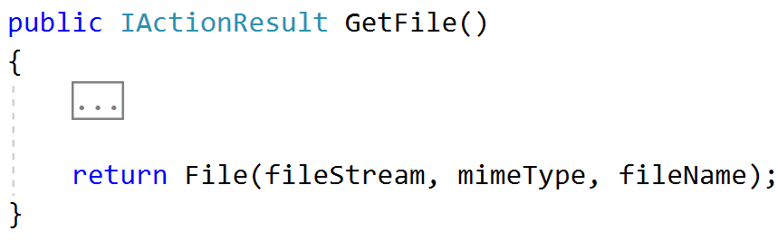
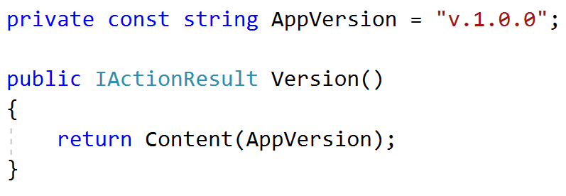
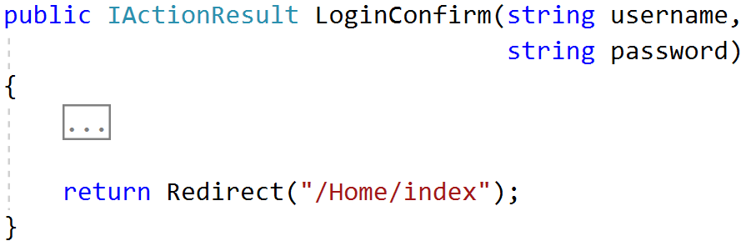
Action Results
Controller action response to a browser request
Represent various HTTP Status Codes
Inherit from the base ActionResult class

Slide 15
Action Results (2)
Name | Framework Behavior | Helping Method
StatusCodeResult | Returns an HTTP Response Result with given Status | StatusCode() / Ok() BadRequest() / NotFound()
JsonResult | Returns data in JSON format | Json()
RedirectResult | Redirects the client to a new URL | Redirect() / RedirectPermanent()
RedirectToRouteResult | Redirect to another action, or another controller’s action | RedirectToRoute() / RedirectToAction()
ViewResult PartialViewResult | Response is the responsibility of a view engine | View() / PartialView()
ContentResult | Returns a string literal | Content()
EmptyResult | No response, no content-type header
FileContentResult FilePathResult FileStreamResult | Return the contents of a file | File() / PhysicalFile()

Slide 16
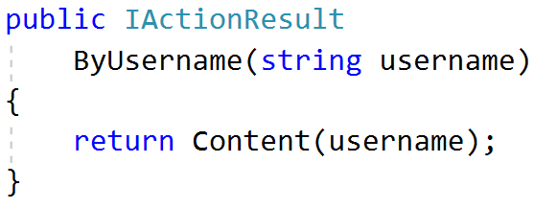
Action Parameters
ASP.NET Core maps the data from the HTTP request to action parameters in few ways:
Routing engine can pass parameters to actions
http://localhost/Users/Niki
Routing pattern: Users/{username}
URL query string can contains parameters
/Users/ByUsername?username=NikolayIT
HTTP post data can also contain parameters

Slide 17
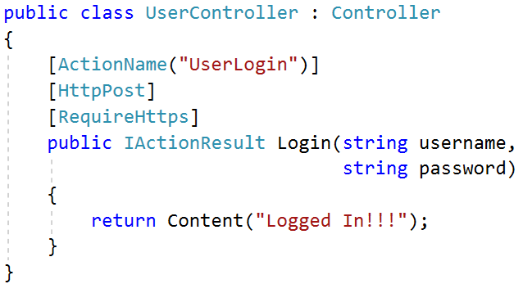
Action Selectors
ActionName(string name)
AcceptVerbs
HttpPost
HttpGet
HttpDelete
HttpOptions
…
NonAction
RequireHttps
etc.

Slide 18
ASP.NET Core MVC Routing

Slide 19
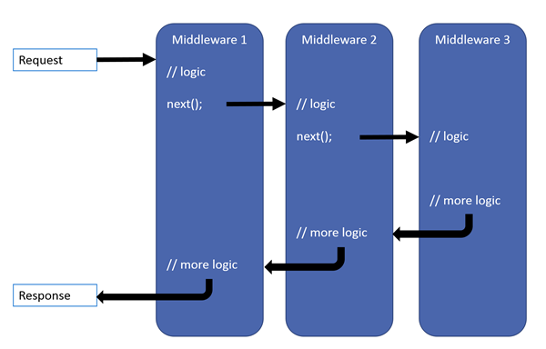

ASP.NET Core MVC Routing
ASP.NET Core MVC uses a middleware for Routing on client requests.
Routes describe how request URL paths should be mapped to Controller Actions.
There are 2 types of Action routing
Conventional
Attribute

Slide 20
Conventional Routing
Called Conventional because it establishes a convention for URL paths.
public void Configure(IApplicationBuilder app, IHostingEnvironment env)
{
app.UseMvc(routes =>
{
routes.MapRoute(
name: "default",
template: "{controller=Home}/{action=Index}/{id?}");
});
}
Will match a route like “/Cats/Show/1”.
Will extract the route values:
{ controller = Cats, action = Show, id = 1 }

Slide 21
Conventional Routing
Using Conventional Routing, with the default route:
Optimizes an application by preventing the creation of a new URL pattern for every Action.
Ensures URL consistency in CRUD style applications.
Simplifies code and makes the UI more predictable.
Can also be implemented like this:
public void Configure(IApplicationBuilder app, IHostingEnvironment env)
{
app.UseMvcWithDefaultRoute();
}

Slide 22
Route Constraints
Route Constraints are rules on the URL segments
All the constraints are regular expression compatible with the Regex class
Defined as one of the routes.MapRoute(…) parameters
routes.MapRoute(
name: "blog",
template: "{year}/{month}/{day}",
defaults: new { controller = "Blog", action = "ByDate" },
constraints: new { year = @"\d{4}", month = @"\d{1,2}", day = @"\d{1,2}", });

Slide 23
Attribute Routing
Attribute routing uses a set of attributes to map actions directly to route templates.
public void Configure(IApplicationBuilder app, IHostingEnvironment env)
{
app.UseMvc();
}
Empty method call
public class HomeController : Controller
{
[Route("/")]
public IActionResult Index()
{
return View();
}
}

Slide 24
Attribute Routing
Attribute routing can also directly define the Request Method.
public class HomeController : Controller
{
//...
[HttpGet("/")]
public IActionResult Index()
{
return View();
}
}
public class UsersController : Controller
{
//...
[HttpPost("Login")]
public IActionResult Login()
{
return View();
}
}
Http{action} attributes are quite often used in REST APIs.

Slide 25
Attribute Routing
Attribute routing allows you to create multiple routes for a single action.
It also allows you to combine a Route for a Controller and an Action Route.
[Route("Home")]
public class HomeController : Controller
{
//...
[Route("/")] // Does not combine, Route – /
[Route("Index")] // Route - /Home/Index
[Route("")] // Route - /Home
public IActionResult Index()
{
return View();
}
}
public class HomeController : Controller
{
//...
[Route("/")]
[Route("Index")]
public IActionResult Index()
{
return View();
}
}

Slide 26
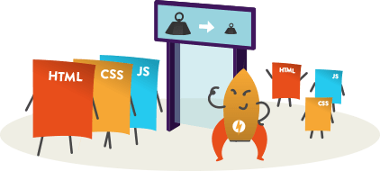
Static File Routing

Slide 27
Static Files
Static files are a necessity for a web application to work.
Files such as HTML, CSS, JS, and different Assets can be served directly to Clients with ASP.NET Core
public void Configure(IApplicationBuilder app, IHostingEnvironment env)
{
app.UseStaticFiles();
}
This will tell the ASP.NET Core App to serve the static files in the wwwroot directory.

Slide 28
Static Files
Can be modified to serve other folders.
public void Configure(IApplicationBuilder app, IHostingEnvironment env)
{
app.UseStaticFiles(); // For the wwwroot folder
app.UseStaticFiles(new StaticFileOptions()
{
FileProvider = new PhysicalFileProvider(
Path.Combine(Directory.GetCurrentDirectory(), "OtherFiles")),
RequestPath = new PathString("/files")
});
}
Folder in Project
This will serve “style.css” file upon request “http://{app}/files/style.css” from “OtherFiles” instead of “wwwroot”

Slide 29

Razor View Engine

Slide 30
Views
HTML templates of the application
A lot of view engines available
View engines execute code and provide HTML
Provide a lot of helpers to easily generate HTML
The most popular is Razor View Engine
We can pass data to views through:
ViewBag, ViewData and Model (strongly-typed views)

Slide 31
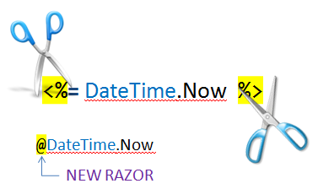
Razor
Template markup syntax
Simple-syntax view engine
Based on the C# programming language
Enables the programmer to use an HTML construction workflow
Code-focused templating approach, with minimal transition between HTML and code
Razor syntax starts code blocks with a @ character and does not require explicit closing of the code-block

Slide 32

Passing Data to a View
With ViewBag (dynamic type):
Action: ViewBag.Message = "Hello World!";
View: @ViewBag.Message
With ViewData (dictionary)
Action: ViewData["message"] = "Hello World!";
View: @ViewData["message"]
With Strongly-typed views:
Action: return View(model);
View: @model ModelDataType;

Slide 33

ASP.NET Core Identity System
Overview

Slide 34

ASP.NET Identity
The ASP.NET Core Identity system
Authentication and authorization system for ASP.NET Core Web apps
Supports ASP.NET Core MVC, Web API, SignalR
Handles Users, User Profiles, Login / Logout, Roles, etc.
Keeps the user accounts in local DB or in external data store
Included via middleware:
app.UseAuthentication();

Slide 35

Areas

Slide 36
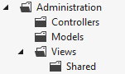
Areas
Some applications can have a large number of components
We can partition Web applications into smaller units (Areas)
An Area is effectively an MVC structure inside an application
Example: large e-commerce application
Store, users, Blog, forum, administration
To use areas you should change the default route template:
routes.MapRoute(
name: "areas",
template: "{area:exists}/{controller=Home}/{action=Index}/{id?}"
);

Slide 37

Summary
ASP.NET Core MVC
Controllers & Actions
Routing
Conditional & Attribute Routing
Static File Routing
Razor Engine
Identity
Areas
…
…
…

Slide 38
https://softuni.bg/trainings/courses

Slide 39











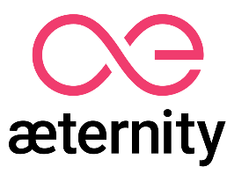

SoftUni Diamond Partners

Slide 40





SoftUni Organizational Partners

Slide 41




Trainings @ Software University (SoftUni)
Software University – High-Quality Education and Employment Opportunities
softuni.bg
Software University Foundation
http://softuni.foundation/
Software University @ Facebook
facebook.com/SoftwareUniversity
Software University Forums
forum.softuni.bg

Slide 42

License
This course (slides, examples, demos, videos, homework, etc.) is licensed under the "Creative Commons Attribution-NonCommercial-ShareAlike 4.0 International" license

